Slide 1
Hunan University Computer Archticture Persentation
Name: Yoseph Sebisbe Demeke
ID: LY2021035

Slide 2
A Deeper Look into RowHammer’s Sensitivities: Experimental Analysis of Real DRAM Chips and Implications on Future Attacks and Defenses
BY: Lois Orosa, A. Giray Yağlıkçı, Hasan Hassan
Ataberk Olgun, Onur Mutlu, Jisung Park,
Minesh Patel, Jeremie S. Kim,Haocong Luo

Slide 3
Content Overview
Rowhammer and motivation
Experimental Methodology
Temperature Analysis
Aggresor Row Active Time Analysis
Spatial Variation Analysis
Implications on Attacks and Defenses
Conculusions

Slide 4
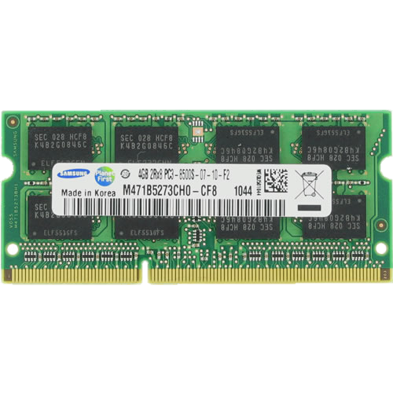
DRAM Organization
Subarray
Bitline
DRAM Cell
Bank
Wordline
…
Chip I/O
. . .
DRAM Row
…
…
…
…
…
Row Buffer
DRAM Chip
DRAM Bank
DRAM Subarray
Notes:
This is a DRAM module, used as the main memory on many systems. [CLICK]
A DRAM module consists of multiple chips each of which contains multiple banks [CLICK]
Each bank is composed of multiple subarrays [CLICK]
And within each subarray, there is a two dimensional array of DRAM cells. [CLICK]
These cells are organized into rows that are selected using wordlines [CLICK]
And the cells are connected to a row buffer via bitlines [CLICK]

Slide 5
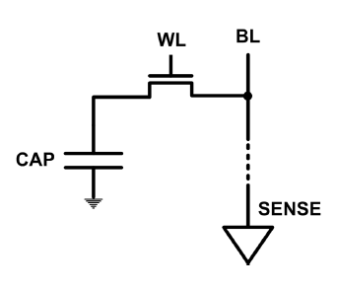
DRAM cell arrangement
with reduction in transistor size DRAM cells became smaller.
as DRAM cells became smaller, the space between two such cells reduce
clother the two chargesd bodeis higher elecromagnetic interference.
DRAM capacity, cost, and energy/power hard to scale

Slide 6
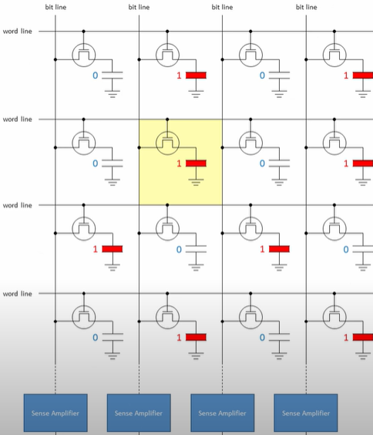
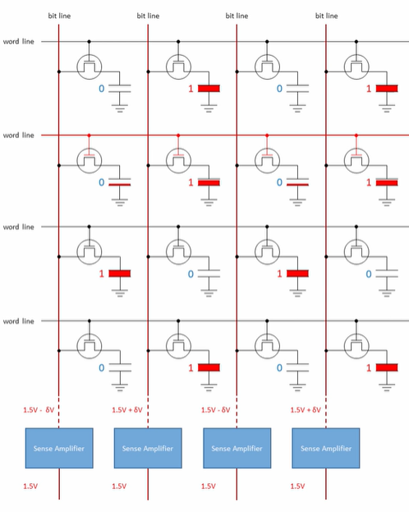
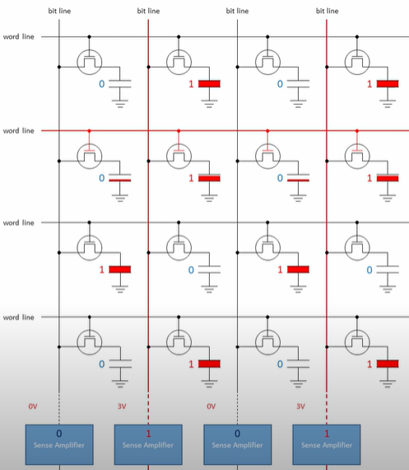
How DRAM Write And Read bits

Slide 7
Why Is RowHammer Happening?
DRAM cells are too close to each other!
They are not electrically isolated from each other
Access to one cell affects the value in nearby cells
due to electrical interference between
the cells
wires used for accessing the cells
Also called cell-to-cell coupling/interference
Example: When we activate (apply high voltage) to a row, an adjacent row gets slightly activated as well
Vulnerable cells in that slightly-activated row lose a little bit of charge
If row hammer happens enough times, charge in such cells gets drained

Slide 8
DRAM refresh cycles
as time passes the charges in the memory cells (capacitors) leak away, so without being refreshed the strored data would eventually be lost.
To pervent this, external circuitry periodically reads each cells and rewrites it, restoring the charge on the capacitor to its original level.
Refresh cycles are in orders of milliseconds though, consume some memory bandwidth.
what is RowHammer?
Rowhammer is a vulnerability in DRAM chips that allows attackers to take advantage of devices by repeatedly triggering bit flips to exposing data

Slide 9
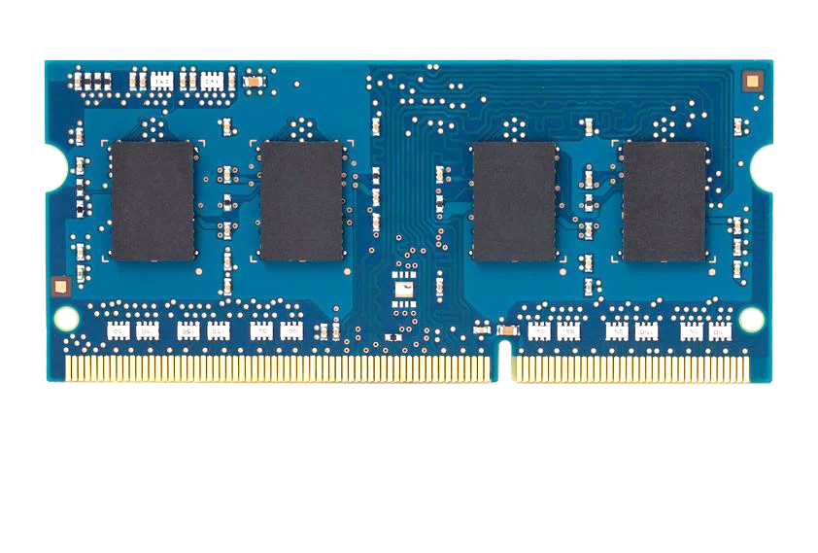
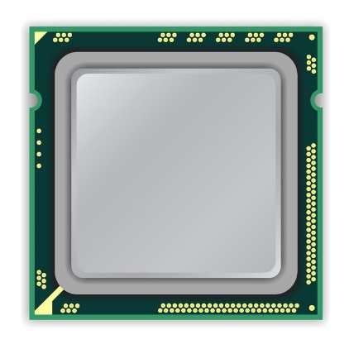
A Simple Program Can Induce Many Errors
CPU
DRAM Module
loop:
mov (X), %eax
mov (Y), %ebx
clflush (X)
clflush (Y)
mfence
jmp loop
X
Y
Download from: https://github.com/CMU-SAFARI/rowhammer
Notes:
We demonstrate the errors on multiple x86 systems. Shown to the bottom-left is a “disturbance kernel”. When executed, it forces two rows to be opened and closed one after the other – over and over again. Consequently, it induces many errors in the module.

Slide 10
A Simple Program Can Induce Many Errors
CPU
DRAM Module
loop:
mov (X), %eax
mov (Y), %ebx
clflush (X)
clflush (Y)
mfence
jmp loop
X
Y
Download from: https://github.com/CMU-SAFARI/rowhammer
Notes:
We demonstrate the errors on multiple x86 systems. Shown to the bottom-left is a “disturbance kernel”. When executed, it forces two rows to be opened and closed one after the other – over and over again. Consequently, it induces many errors in the module.

Slide 11
A Simple Program Can Induce Many Errors
CPU
DRAM Module
loop:
mov (X), %eax
mov (Y), %ebx
clflush (X)
clflush (Y)
mfence
jmp loop
X
Y
Download from: https://github.com/CMU-SAFARI/rowhammer
Notes:
We demonstrate the errors on multiple x86 systems. Shown to the bottom-left is a “disturbance kernel”. When executed, it forces two rows to be opened and closed one after the other – over and over again. Consequently, it induces many errors in the module.

Slide 12

Motivation
2020
More than 10X reduction
Manufactured Year
2014
Minimum Activation Count to Observe a Bit Flip
Defenses are becoming prohibitively expensive
A deeper understanding is needed
No rigorous experimental study on fundamental properties of RowHammer to find effective and efficient solutions
It is critical to gain insights into RowHammer and its fundamental properties
Notes:
RowHammer is a DRAM reliability and security problem [CLICK]
Denser DRAM chips are significantly more vulnerable to RowHammer, such that [CLICK]
the minimum activation count to observe a bit flip has reduced by more than an order of magnitude in less than a decade [CLICK]
Recent works have demostrated that many defense mechanisms are becoming prohibitively expensive for future DRAM chips [CLICK]
A deeper understanding of RowHammer is the key to overcome this challenge [CLICK]
However, no rigorous experimental study demonstrates a set of fundamental properties of RowHammer to find effective and efficient solutions [CLICK]
Therefore, to enable RowHammer-safe operation with future DRAM chips, it is critical to gain insights into RowHammer and its fundamental properties[CLICK]

Slide 13
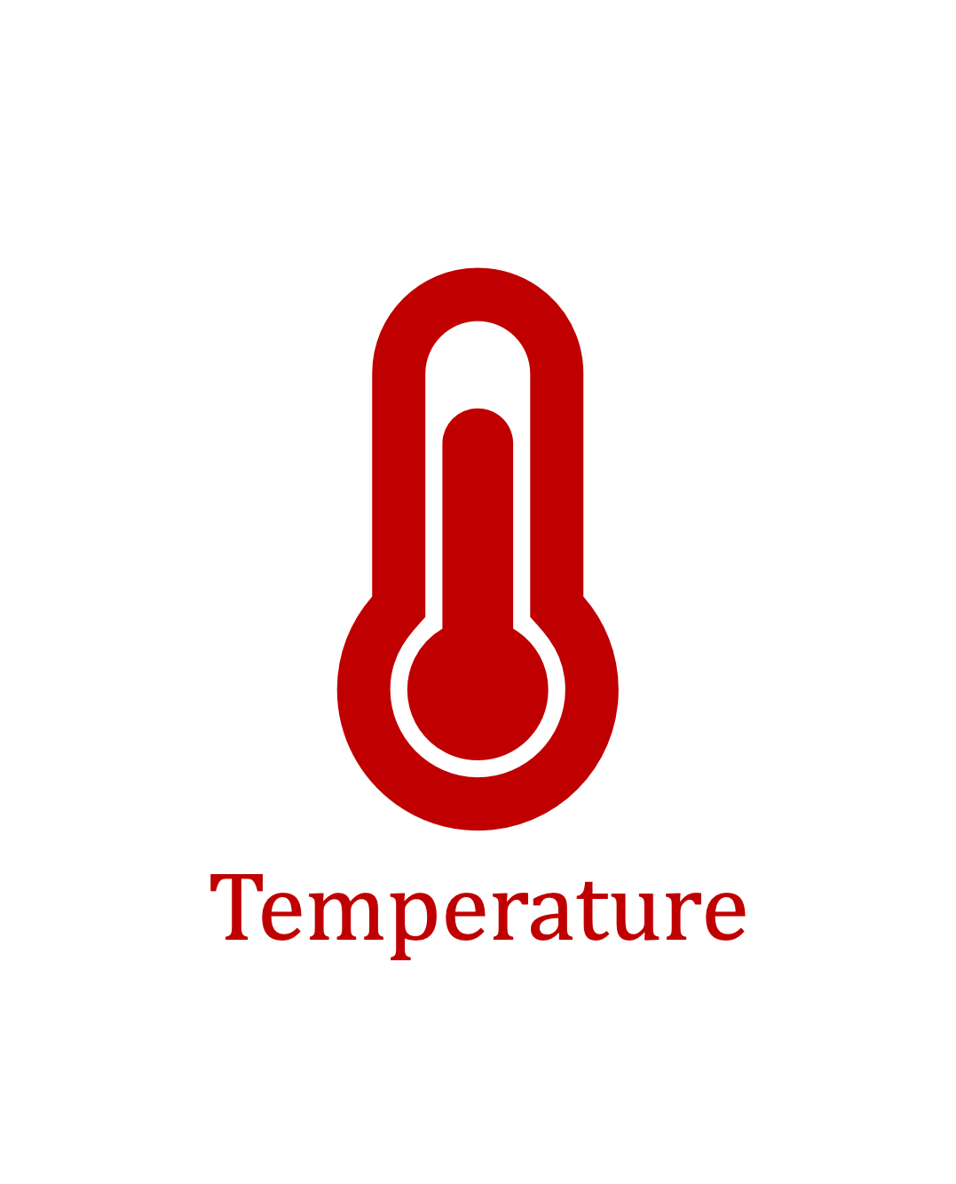


Our Goal
Provide insights into three fundamental properties
To find effective and efficient attacks and defenses
Notes:
Our goal in this work is to Provide insights into three fundamental properties of RowHammer:
Temperature [CLICK]
Aggressor row active time [CLICK]
Victim DRAM cell's physical location [CLICK]
By doing so we aim enabling research to find effective and efficient attacks and defenses [CLICK]

Slide 14
Experimental Methodology
Two separate testing infrastructures
DDR3: FPGA-based SoftMC (Xilinx ML605)
DDR4: FPGA-based SoftMC (Xilinx Virtex UltraScale+ XCU200)
FBGA: Field Programmable Gate Arrays are semiconductor devices that are based around a matrix of configurable logic blocks (CLBs)
Temperature Controller. To regulate the temperature inDRAM modules, they use silicone rubber heaters pressed to bothsides of the DRAM moduleFine-grained control over DRAM commands,
They use the SoftMC memory controller
controls the heater pads using a closed-loop PID controller
timing parameters and temperature (±0.1°C )

Slide 15
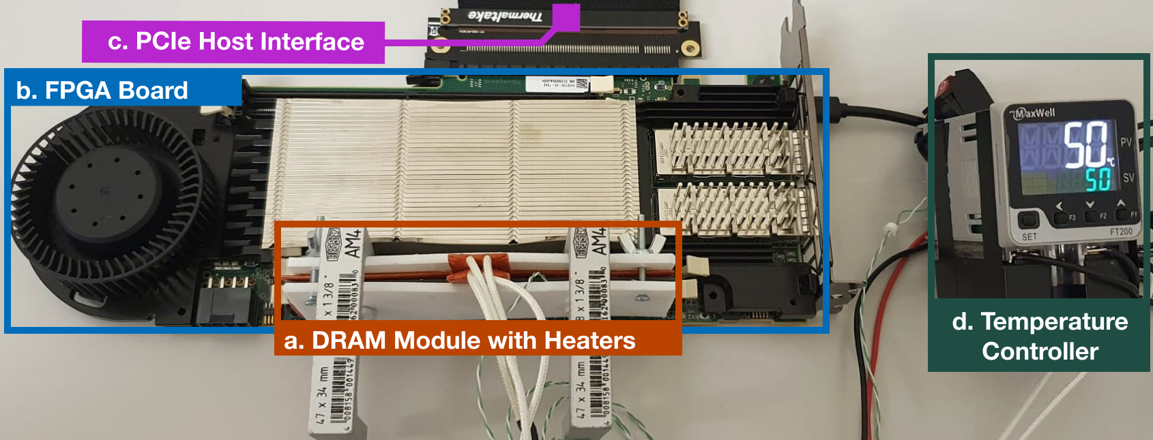
Fig. 2: SoftMC Infrastructure: (a) DRAM module under test clamped with heater pads, (b) Xilinx Alveo U200 FPGA board [161], programmed with a DDR4 version of SoftMC [40], (c) PCIe connection to the host machine, and (d) temperature controller.

Slide 16
DRAM Testing Methodology
To characterize our DRAM chips at worst-case conditions:
Prevent sources of interference during core test loop
No DRAM refresh: to avoid refreshing victim row
No DRAM calibration events: to minimize variation in test timing
No RowHammer mitigation mechanisms: to observe circuit-level effects (TRR)
Test for less than a refresh window (32ms) to avoid retention failures
Fourth, they test DRAM modules that do not implement error correction codes (ECC)
Worst-case access sequence
We use worst-case access sequence based on prior works’ observations
For each row, repeatedly access the two physically-adjacent rows as fast as possible
Notes:
To characterize our DRAM chips at worst-case conditions we take two measures:
[CLICK] First, we prevent external sources of interference such that our tests can run consistently as desired and without interruptions. To achieve this we disable:
[CLICK] DRAM refresh to avoid refreshing victim rows during a RowHammer test,
[CLICK] DRAM calibration events to minimize variation in test timings
[CLICK] and RowHammer mitigation mechanisms to ensure that we can directly observe circuit-level bit flips
[CLICK] we also ensure that our tests complete in less than a refresh window to prevent retention failures from interfering with our results
[CLICK] Second, we issue the worst-case access sequence for inducing RowHammer bit flips based on observations from prior work
[CLICK] Using these observations, we test each row’s worst-case vulnerability to RowHammer by repeatedly activating the two physically-adjacent rows as fast as possible
=========

Slide 17
DRAM Testing Methodology
They use 150K hammers (i.e., 300Kactivations) in their BER experiments. They use up to 512K hammers (i.e., the maximum number of hammers so that their hammer tests run for less than 64ms)
They measure two metrics in our Their tests:
1) the minimum hammer count value at which the first bit error is observed (HCfirst)
2) the number of bit flips in a DRAM row, referred to as bit error rate (BER).
the 248 DDR4 and 24 DDR3 DRAM chips we test from four major manufacturers.

Slide 18
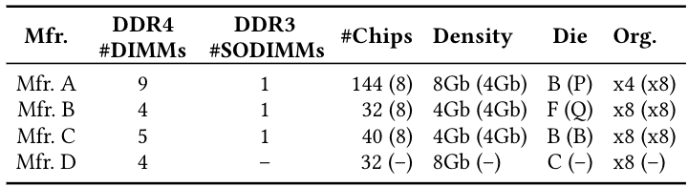
DRAM Chips Tested
Two DRAM standards
Mfr. | DDR4 DIMMs | DDR3 SODIMMs | # Chips | Density | Die | Org.
A (Micron) | 9 | 1 | 144 (8) | 8Gb (4Gb) | B (P) | x4 (x8)
B (Samsung) | 4 | 1 | 32 (8) | 4Gb (4Gb) | F (Q) | x8 (x8)
C (SK Hynix) | 5 | 1 | 40 (8) | 4Gb (4Gb) | B (B) | x8 (x8)
D (Nanya) | 4 | - | 32 (-) | 8Gb (-) | C (-) | x8 (-)
4 Major Manufacturers
272 DRAM Chips in total
Notes:
In our characterization, [CLICK]
we test 272 real DRAM chips [CLICK]
from four major manufacturers, [CLICK]
that implement DDR3 and DDR4 DRAM standards [CLICK]
and with different densities, die revisions, and chip organizations[CLICK]

Slide 19
Temperature Analysis

Slide 20
Key Takeaways from Temperature Analysis
Key Takeaway 1
To ensure that a DRAM cell is not vulnerable to RowHammer,
we must characterize the cell at all operating temperatures
Key Takeaway 2
RowHammer vulnerability tends to worsen as DRAM temperature increases
However, individual DRAM rows can exhibit behavior different from the dominant trend
Notes:
This analysis provides two key takeaway lessons: [CLICK]
First, To ensure that a DRAM cell is not vulnerable to RowHammer, we must characterize the cell at all operating temperatures [CLICK]
Second, RowHammer vulnerability tends to worsen as DRAM temperature increases [CLICK]
However, individual DRAM rows can behave differently from the dominant trend [CLICK]

Slide 21
Impact of Temperature on DRAM Cells
no bit flips
bit flips
no bit flips
Vulnerable Temperature Range
Temperature
Lower
Bound
Upper
Bound
The fraction of vulnerable DRAM cells, experiencing bit flips at all temperature levels within their vulnerable temperature range
Mfr. A | Mfr. B | Mfr. C | Mfr. D
99.1% | 98.9% | 98.0% | 99.2%
OBSERVATION 1
Most DRAM cells are vulnerable to RowHammer throughout a continuous temperature range
Notes:
We analyze the temperature levels a DRAM cell is vulnerable to RowHammer [CLICK]
We observe that there exists [CLICK] a lower and [CLICK] an upper bound of temperature [CLICK]
A DRAM cell experiences bit flips only within this bounded range[CLICK]
but we do not observe any bit flips out of this range [CLICK]
We call this range: vulnerable temperature range [CLICK]
This table demonstrates the fraction of DRAM cells that experience bit flips at all temperature levels within their vulnerable temperature range
We observe that more than 98% of vulnerable cells across all four manufacturers exhibit this behavior [CLICK]
Therefore, we conclude that most DRAM cells are vulnerable to RowHammer throughout a continuous temperature range [CLICK]

Slide 22
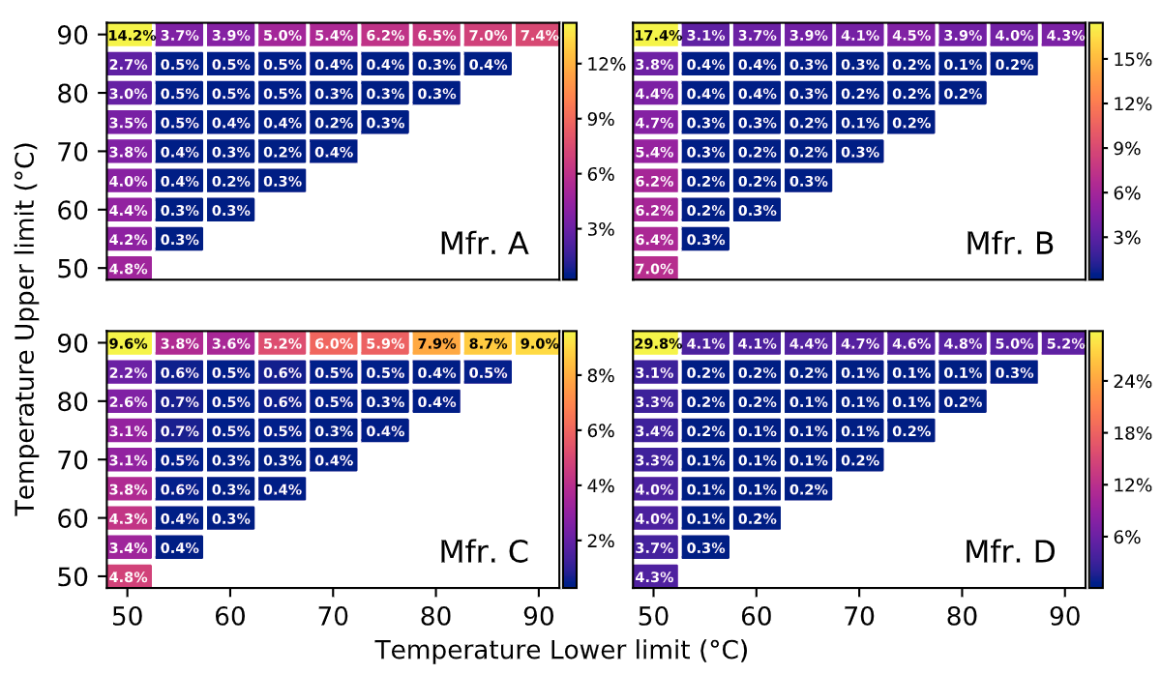
Impact of Temperature on DRAM Cells
Vulnerable from 70°C to 85 ° C
Fraction of Vulnerable DRAM Cells
Upper Bound (°C)
Vulnerable
from 55°C to 60°C
Lower Bound (°C)
Different DRAM cells are vulnerable to RowHammer within specific temperature ranges
Notes:
This figure shows the population density of cells, clustered based on their vulnerable temperature range. The x-axis and y-axis show the lower bound [CLICK] and the upper bound [CLICK] of a DRAM cell’s vulnerable temperature range [CLICK]
The color-scale and the percentage values show the fraction of cells for a given temperature range [CLICK]
For example, 0.4% of the cells are vulnerable to RowHammer only between 55 and 60 degrees Celsius [CLICK],
while 0.5% of the cells experience bit flips only between 70 and 85 degrees Celsius [CLICK]
We conclude that different DRAM cells are vulnerable to RowHammer within specific temperature ranges [CLICK]

Slide 23
Impact of Temperature on DRAM Cells
Upper Bound (°C)
29.8% of the cells experience bit flips at all tested temperatures
Lower Bound (°C)
OBSERVATION 2
A significant fraction of vulnerable DRAM cells exhibit bit flips at all tested temperatures
Notes:
Here are the results for all four manufacturers.
We make two observations from this figure. [CLICK]
First, we observe that a significant fraction of vulnerable DRAM cells exhibit bit flips at all tested temperatures For example, almost 30% of cells from manufacturer D experience bit flips at all temperatures we tested, [CLICK]

Slide 24
Impact of Temperature on DRAM Cells
Upper Bound (°C)
0.2% of the cells experience bit flips only at 70°C
Lower Bound (°C)
OBSERVATION 3
A small fraction of all vulnerable DRAM cells are vulnerable to RowHammer only in a very narrow temperature range
Notes:
Second, we observe that [CLICK]
a small fraction of the cells from all four manufacturers are vulnerable to RowHammer only in a very narrow temperature range. [CLICK]
For example, 0.2% of the cells from manufacturer D experience bit flips only at 70C. [CLICK]

Slide 25
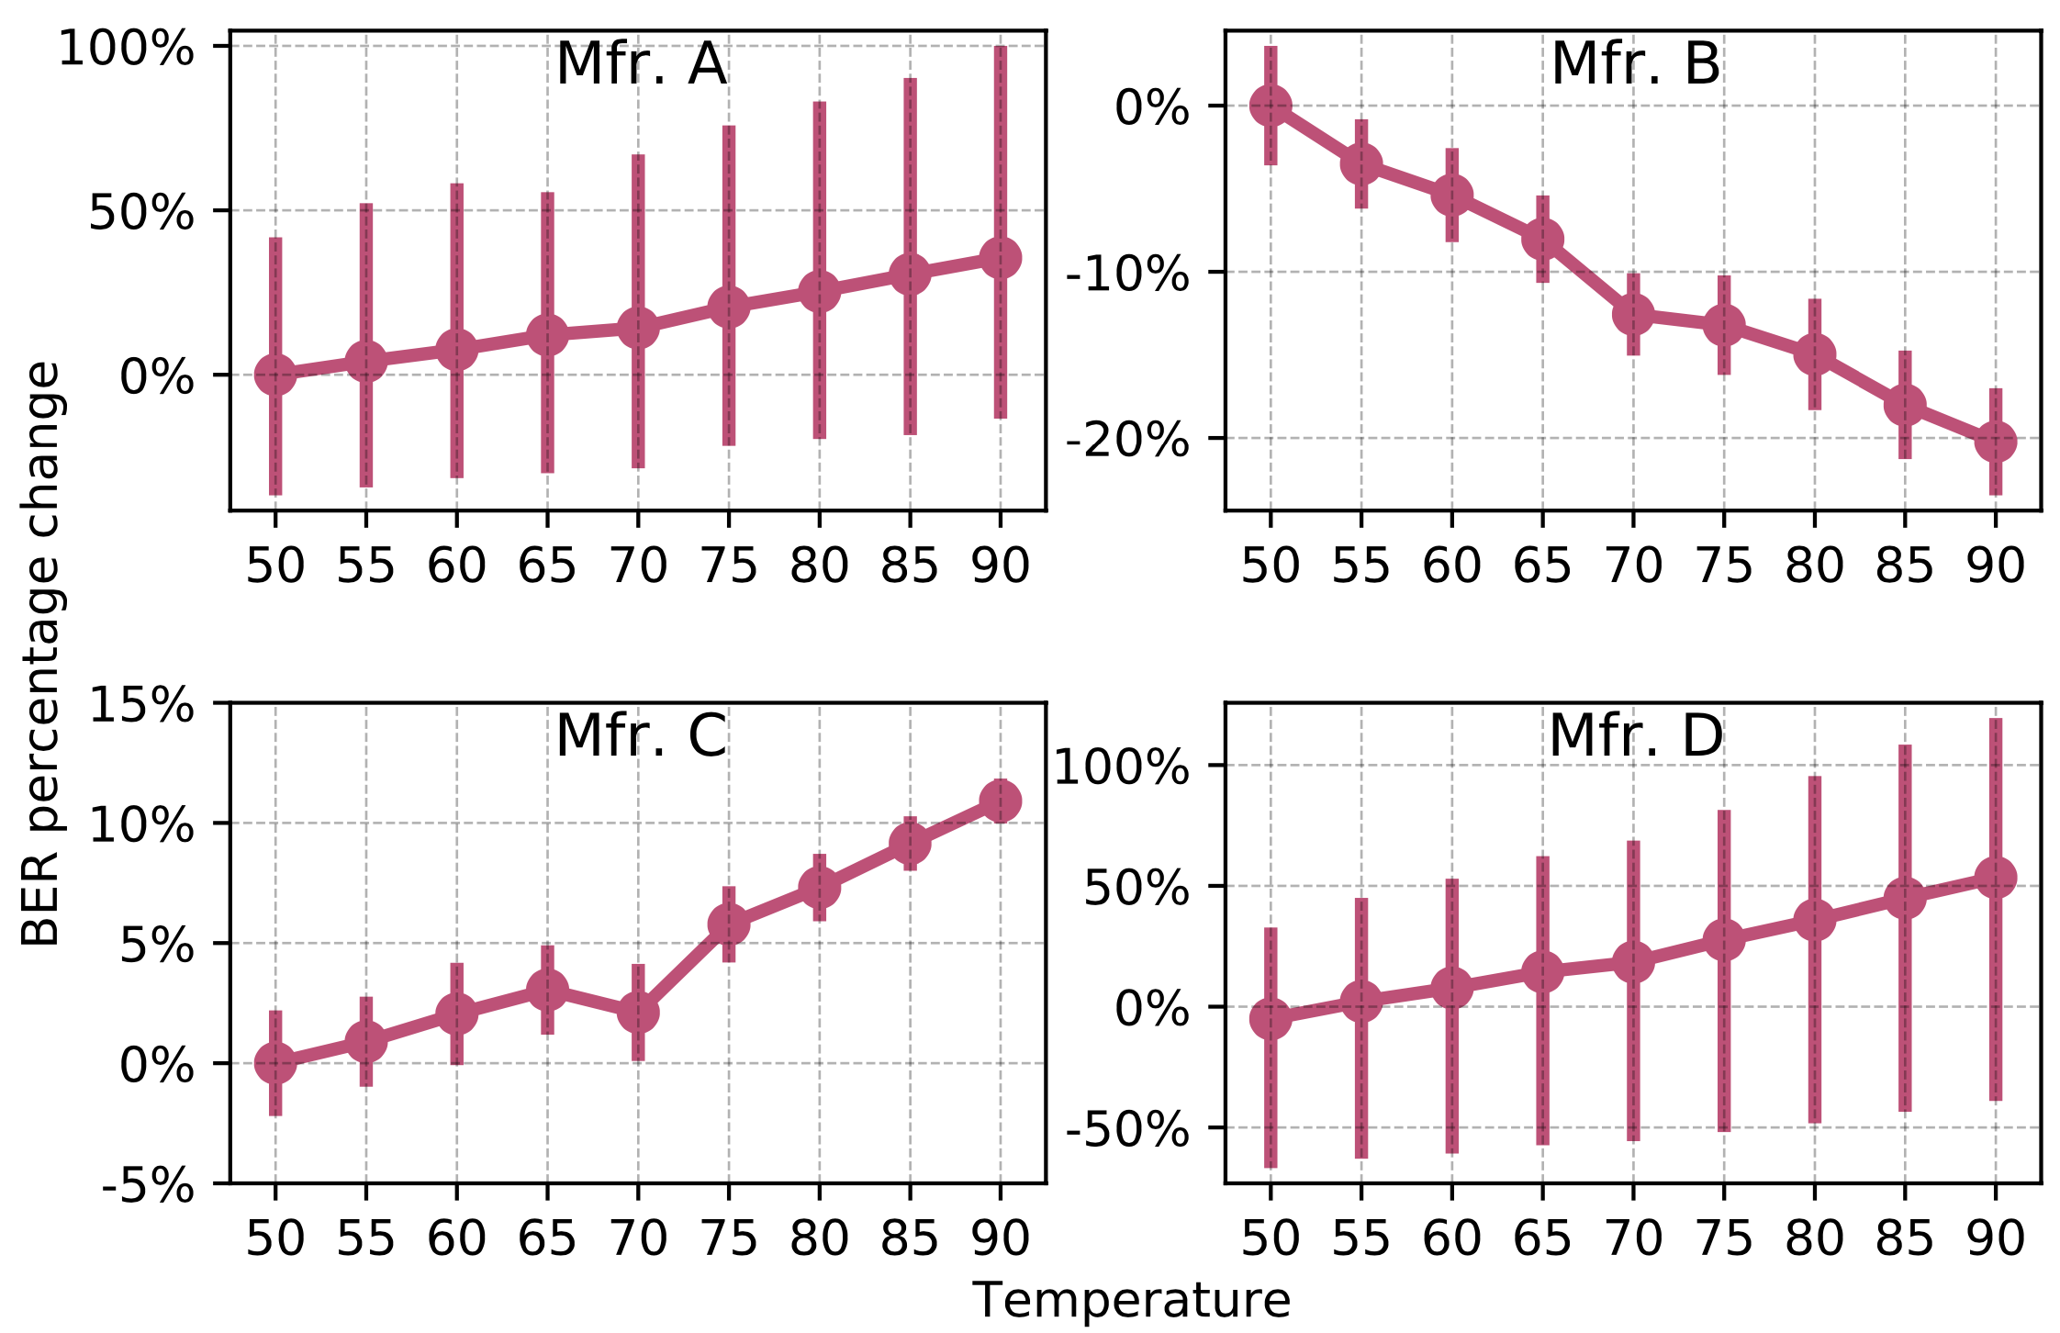
Impact of Temperature on DRAM Rows
Variation in
Bit Flip Counts
per DRAM Row
Temperature (°C)
More cells experience bit flips as temperature increases
Notes:
Next, we study the impact of temperature on DRAM rows. The figure shows how the number of bit flips in the victim row changes as temperature increases.[CLICK]
The x-axis shows the increasing temperature [CLICK] and y-axis reports the variation in bit flip counts normalized to the mean value at 50°C. [CLICK]
We observe that more cells experience a bit flip with increasing temperature, [CLICK]

Slide 26
Impact of Temperature on DRAM Rows
Variation in Bit Flip Counts per DRAM Row
Temperature (°C)
OBSERVATION 4
A DRAM row’s bit error rate can either increase or decrease with temperature depending on the DRAM manufacturer
Notes:
We repeat this analysis for all four manufacturers [CLICK]
We observe that the bit error rate increases with temperature in modules from three manufacturers, [CLICK]
While it exhibits an opposite trend in modules from manufacturer B. We hypothesize that this happens due to different characteristics of charge trap error mechanisms in different manufacturers. Please refer to our full paper for more details [CLICK]
Our main observation from this figure is that A DRAM row’s BER can either increase or decrease with temperature depending on the DRAM manufacturer [CLICK]

Slide 27
Also in the Paper
The minimum activation count at which a victim row experiences a bit flip (HC_{first}) when temperature changes:
OBSERVATION 5
DRAM rows can show either higher or lower HC_{first}
when temperature increases
OBSERVATION 6
HC_{first} tends to generally decrease
as temperature change (ΔT) increases
OBSERVATION 7
The HC_{first} change (ΔHC_{first}) tends to be larger
as temperature change (ΔT) increases
Notes:
In the paper, we also analyze the variation in HCfirst, the minimum activation count at which a victim row experiences a bit flip, and make three observations from this analysis[CLICK]
First, just like BER, DRAM rows can show either higher or lower HC_{first} when temperature increases [CLICK]
Second, Hcfirst tends to generally decrease as delta temperature increases [CLICK]
And third, delta Hcfirst tends to be larger as delta temperature increases [CLICK]

Slide 28
Aggresor Row Active Time Analysis

Slide 29
Key Takeaways from Aggressor Row Active Time Analysis
Key Takeaway 3
As an aggressor row stays active longer,
victim DRAM cells become more vulnerable to RowHammer
Key Takeaway 4
RowHammer vulnerability of victim cells decreases
when the bank is precharged for a longer time
Notes:
This analysis provides two key takeaways: [CLICK]
First, As an aggressor row stays active longer, victim DRAM cells become more vulnerable to RowHammer [CLICK]
And second, RowHammer vulnerability of victim cells decreases when the bank is precharged for a longer time [CLICK]

Slide 30
Memory Access Patterns in Aggressor Row Active Time Analysis
Baseline access pattern:
Increasing aggressor row active time:
Increasing bank precharged time:
Row A is active
Row B is active
Row A is active
Row B is active
Time
Row A is active
Row B is active
Row A is active
Time
Aggressor row active time
Aggressor row active time
Aggressor row active time
Row A is active
Row B is active
Row A is active
Time
Bank precharged time
Bank precharged time
Bank precharged time
Notes:
To perform this analysis, we conduct two sets of experiments [CLICK]
In the baseline, we hammer rows A and B as frequently as possible [CLICK]
In the first set of tests, we increase the time that an aggressor row is active [CLICK],
And in the second set of experiments we increase the time that the bank is precharged [CLICK]

Slide 31
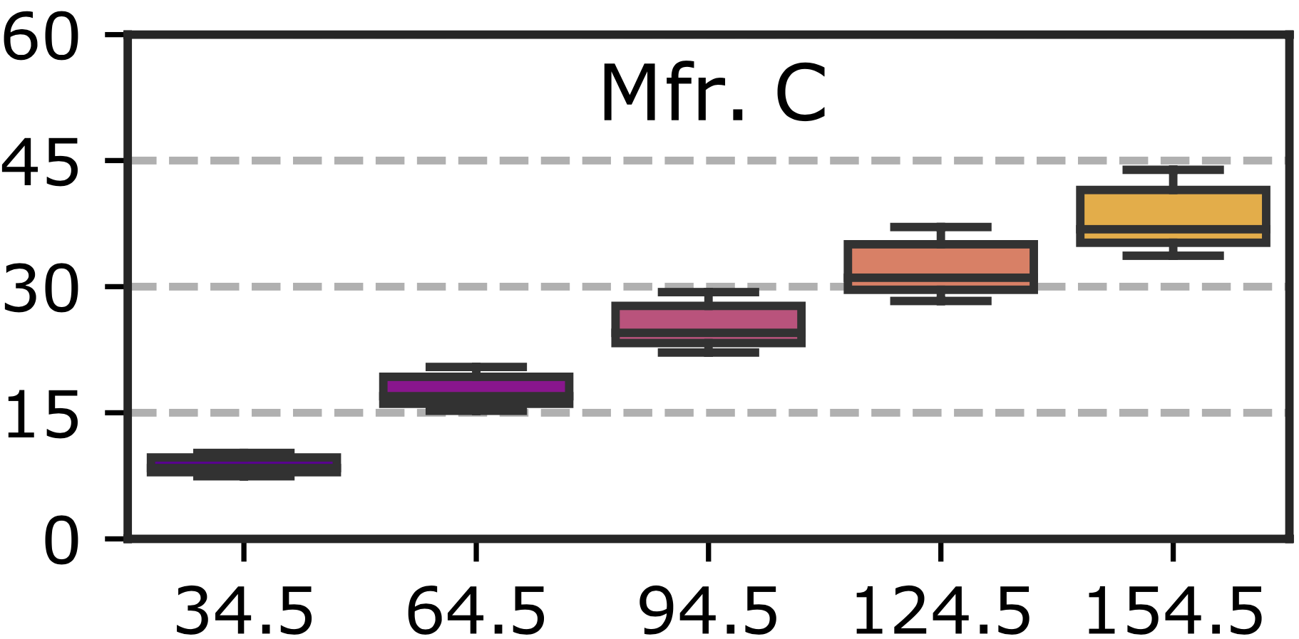
Increasing Aggressor Row Active Time
Number of Bit Flips
per DRAM Row
Aggressor Row Active Time (ns)
As the aggressor row stays active longer, more DRAM cells experience RowHammer bit flips
Notes:
This plot demonstrates how [CLICK]
bit error rate varies [CLICK]
when aggressor row active time increases [CLICK]
We observe that: As the aggressor row stays active longer, more DRAM cells experience RowHammer bit flips [CLICK]

Slide 32
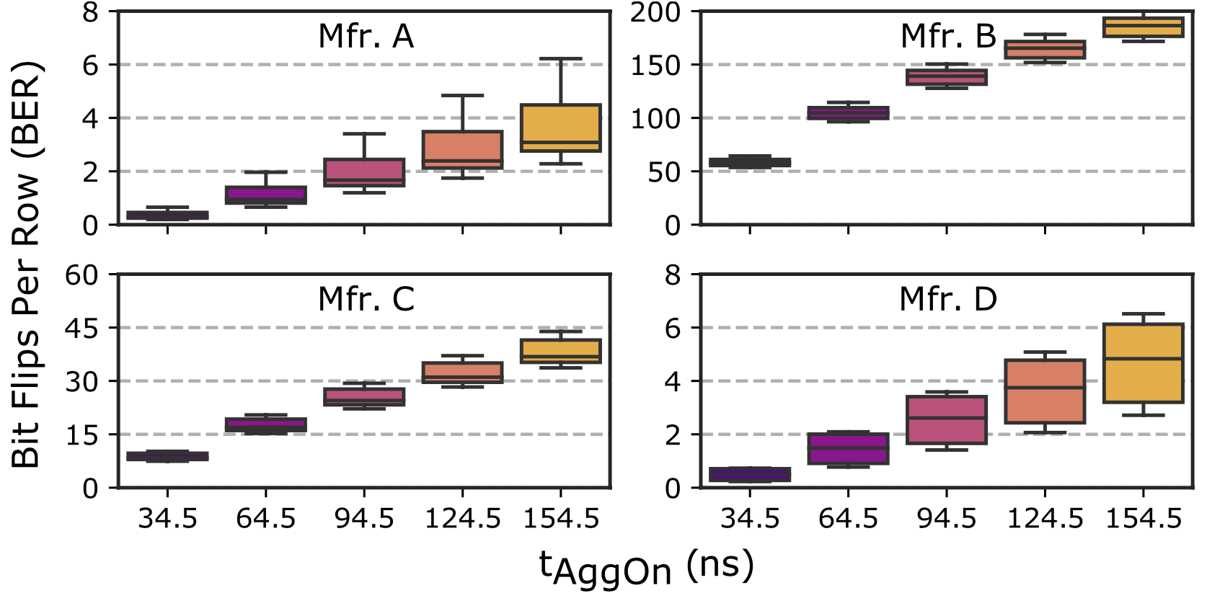
Increasing Aggressor Row Active Time
Number of Bit Flips
per DRAM Row
Aggressor Row Active Time (ns)
As the aggressor row stays active longer, more DRAM cells experience RowHammer bit flips
Notes:
We observe the same trend on modules from all four manufacturers [CLICK]

Slide 33
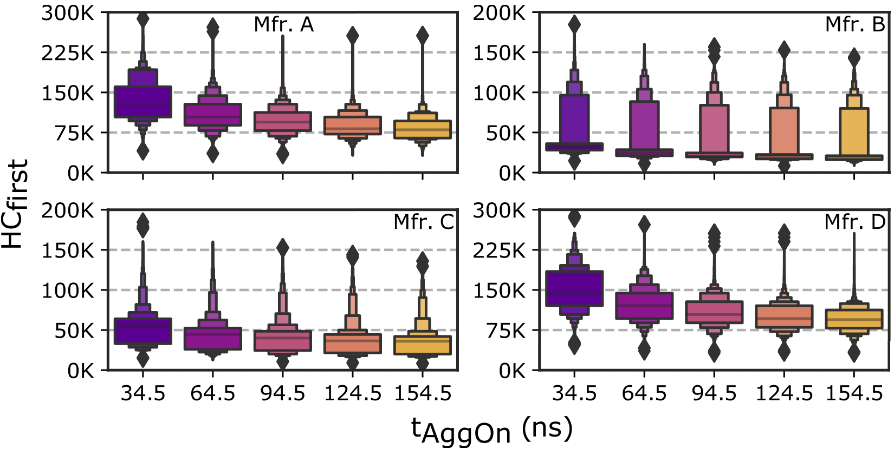
Increasing Aggressor Row Active Time
Minimum Activation Count
to Observe a Bit Flip (HC_{first})
Aggressor Row Active Time (ns)
Fewer activations are required to cause RowHammer bit flips when aggressor rows stay active for longer time
Notes:
In this plot, we investigate the variation in Hcfirst, [CLICK]
the minimum activation count to observe a bit flip [CLICK]
With increasing aggressor row active time [CLICK]
We observe that DRAM cells experience bit flips at smaller activation counts when aggressor rows stay active longer [CLICK]

Slide 34
Increasing Aggressor Row Active Time
Minimum Activation Count
to Observe a Bit Flip (HC_{first})
Aggressor Row Active Time (ns)
OBSERVATION 8
As the aggressor row stays active longer, more DRAM cells experience RowHammer bit flips and they experience RowHammer bit flips at lower activation counts
Notes:
We observe the same trend on modules from all four manufacturers [CLICK]
Based on our observations on the bit error rate and Hcfirst, we conclude that: as the aggressor row stays active longer, more DRAM cells experience RowHammer bit flips AND they experience RowHammer bit flips at lower activation counts [CLICK]

Slide 35
Also in the Paper
The variation in aggressor row active time’s effects across DRAM rows and the effect of increasing bank precharged time
OBSERVATION 9
As the aggressor row stays active longer, the RowHammer vulnerability consistently worsens across tested DRAM rows
OBSERVATION 10
As the bank stays precharged longer, fewer DRAM cells experience RowHammer bit flips and they experience RowHammer bit flips at higher activation counts
OBSERVATION 11
As the bank stays precharged longer, the RowHammer vulnerability consistently reduces across tested DRAM rows
Notes:
In the paper, we also investigate the variation in aggressor row active time’s effects across DRAM rows and the effect of increasing bank precharged time. We make three observations from this analysis: [CLICK]
First, as the aggressor row stays active longer, the RowHammer vulnerability consistently worsens across all tested DRAM rows [CLICK]
Second, as the bank stays precharged longer, fewer DRAM cells experience RowHammer bit flips, and they experience bit flips at higher activation counts [CLICK]
Third, this reduction in RowHammer vulnerability is also consistent across all tested DRAM rows [CLICK]

Slide 36
Spatial Variation Analysis

Slide 37
Key Takeaways from Spatial Variation Analysis
Key Takeaway 5
RowHammer vulnerability significantly varies
across DRAM rows and columns due to design-induced
and manufacturing-process-induced variation
Key Takeaway 6
The distribution of the minimum activation count to observe bit flips (HC_{first}) exhibits a diverse set of values in a subarray
but similar values across subarrays in the same DRAM module
Notes:
In this analysis, we investigate how the RowHammer vulnerability varies based on a victim DRAM cell's physical location
We have two key takeaways from this analysis. [CLICK]
First, The RowHammer vulnerability significantly varies across DRAM rows and columns due to both design induced and manufacturing process induced variation [CLICK]
Second, the distribution of HCfirst exhibits
- a diverse set of values within a subarray
- But similar values across subarrays within a DRAM module [CLICK]

Slide 38
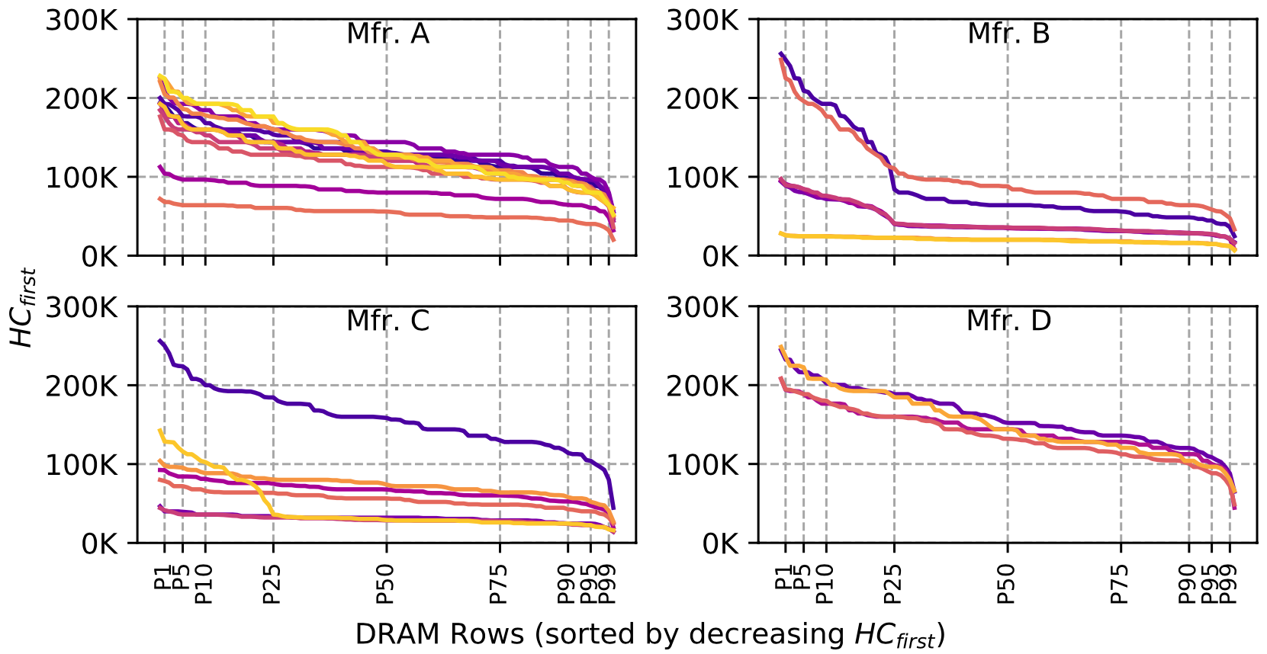
The minimum activation count to observe bit flips (HC_{first}) across DRAM rows:
Minimum Activation Count
to Observe a Bit Flip (HC_{first})
DRAM Rows (sorted by reducing HC_{first})
The RowHammer vulnerability
significantly varies across DRAM rows
Notes:
To do this analysis, we first investigate how Hcfirst, [CLICK]
the minimum activation count to observe bit flips, varies [CLICK]
across different DRAM rows sorted by reducing Hcfirst value on the x-axis.
Each curve in this plot represents a different DRAM module [CLICK]
We observe that Hcfirst values and thus the RowHammer vulnerability significantly varies across DRAM rows, as we highlight [CLICK]

Slide 39
Spatial Variation across Rows
Min. Activation Count
to Observe a Bit Flip (HC_{first})
DRAM Rows (sorted by reducing HC_{first})
The RowHammer vulnerability
significantly varies across DRAM rows
Notes:
This significant variation can be observed on modules from all four manufacturers

Slide 40
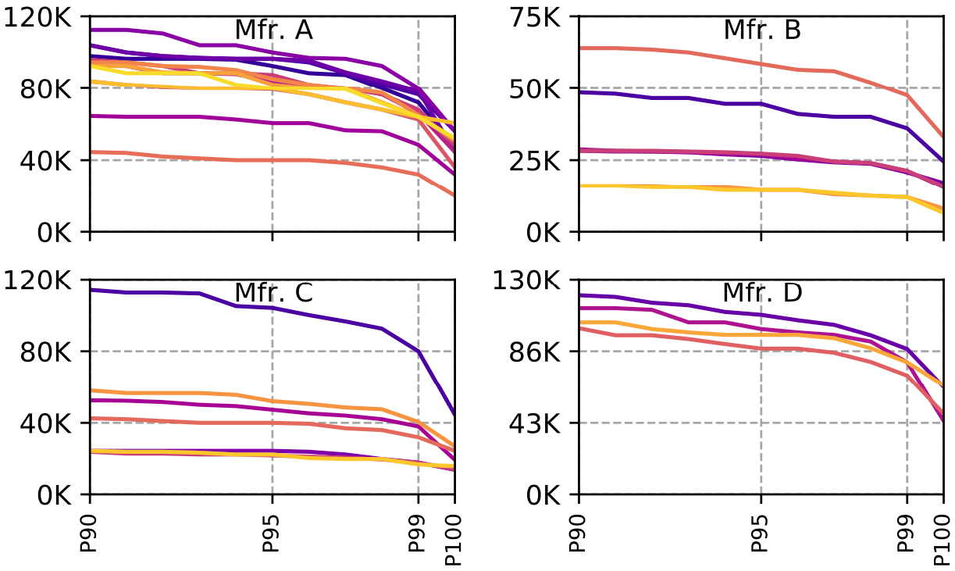
Spatial Variation across Rows
Minimum Activation Count
to Observe a Bit Flip (HC_{first})
DRAM Rows (sorted by reducing HC_{first})
OBSERVATION 12
A small fraction of DRAM rows are significantly more vulnerable to RowHammer than the vast majority of the rows
Notes:
Zooming into the most vulnerable DRAM rows, [CLICK]
We observe that the most vulnerable 10% of the rows experience bit flips at activation counts about half the Hcfirst of the other rows [CLICK]
Therefore, we conclude that a small fraction of DRAM rows are significantly more vulnerable to RowHammer than the vast majority of the rows [CLICK]

Slide 41
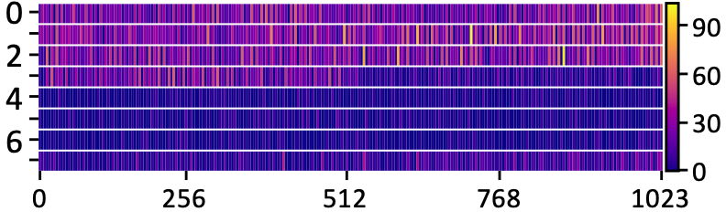
Spatial Variation across Columns
Number of Bit Flips in a Column
Chip ID
Column Index
OBSERVATION 13
Certain columns are significantly more vulnerable
to RowHammer than other columns
Notes:
To investigate how the RowHammer vulnerability varies across columns, we generate a heatmap plot of [CLICK]
bit error rates [CLICK]
across columns [CLICK]
and chips [CLICK]
We observe that bit errors concentrate on certain DRAM columns more than others, implying that certain columns are significantly more vulnerable to RowHammer than other columns [CLICK]

Slide 42
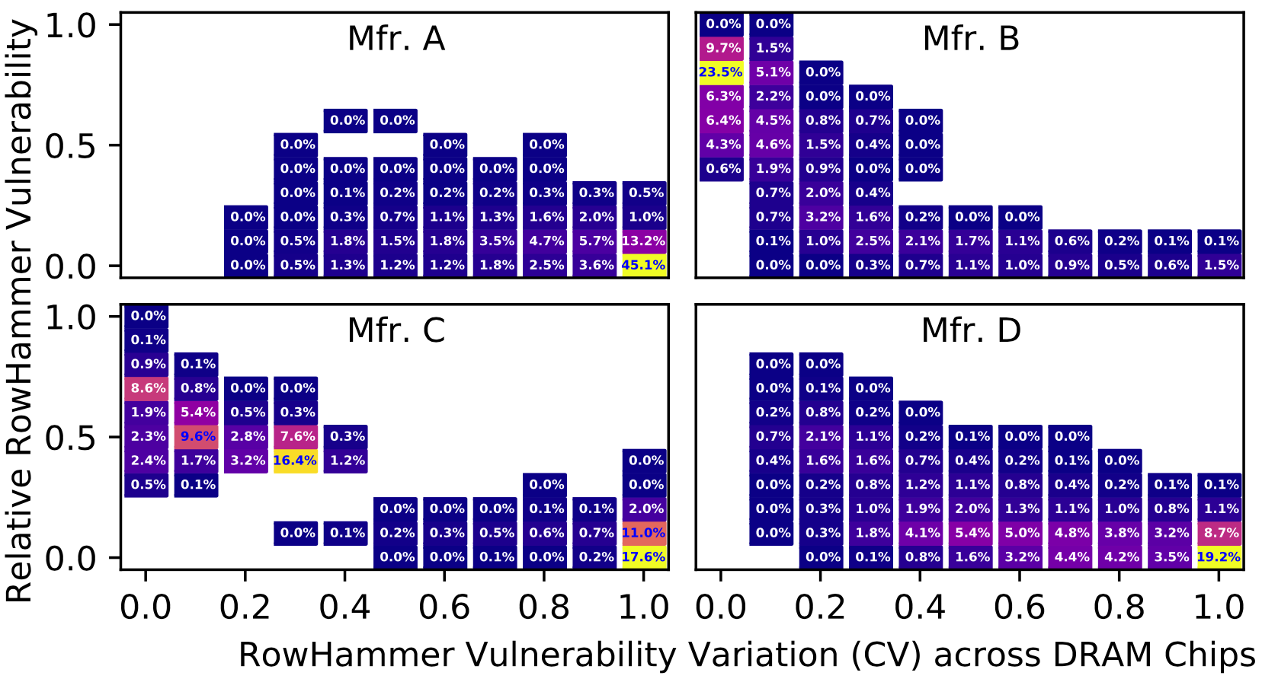
Spatial Variation across Columns
High RowHammer vulnerability across all chips
→design-induced variation
16.7%
1.0
0.5
0.0
Worse RowHammer Vulnerability
30.6%
0.0 0.2 0.4 0.6 0.8 1.0
Larger Variation across DRAM Chips
High variation in vulnerability across chips
→ manufacturing-process-induced variation
Notes:
To further investigate the variation across columns and chips, we cluster each DRAM column based on [CLICK]
its RowHammer vulnerability on average across DRAM chips [CLICK]
and the variation in its vulnerability across DRAM chips
This plot shows the population density of DRAM columns exhibiting a level of RowHammer vulnerability and variation across chips
For example, [CLICK] 16.7% of DRAM columns exhibit a high RowHammer vulnerability across all chips, indicating design-induced variation across columns [CLICK]
In contrast, 30.6% of DRAM columns exhibit a high variation in their RowHammer vulnerability across chips, indicating manufacturing-process-induced variation [CLICK]

Slide 43
Spatial Variation across Columns
50.8%
16.7%
Worse RowHammer Vulnerability
59.8%
30.6%
29.1%
Larger Variation across DRAM Chips
OBSERVATION 14
Both manufacturing process and design
affect a DRAM column’s RowHammer vulnerability
Notes:
Here we see the same analysis for four manufacturers [CLICK]
We observe that there exist columns with very low or very high variation across chips from all four manufacturers [CLICK]
Based on this analysis, we conclude that both manufacturing process and design affect a DRAM column’s RowHammer vulnerability [CLICK]

Slide 44
Also in the Paper
The minimum activation count at which a victim row experiences a bit flip (HC_{first}) across rows in a subarray and across subarrays in a DRAM module:
OBSERVATION 15
The most vulnerable DRAM row in a subarray
is significantly more vulnerable
than the other rows in the subarray
OBSERVATION 16
HC_{first} distributions of subarrays within a DRAM module
are significantly more similar to each other
than those of subarrays from different modules
Notes:
In the paper, we also analyze the variation across rows in a subarray and across subarrays in a DRAM module. We make two observations from this analysis [CLICK]
First, The most vulnerable DRAM row in a subarray is significantly more vulnerable than the other rows in the subarray [CLICK]
Second, HC_{first} distributions of subarrays within a DRAM module are significantly more similar to each other than those of subarrays from different modules [CLICK]

Slide 45
Implications on Attacks and Defenses
Our observations can be leveraged to craft
more effective RowHammer attacks
Our observations can be leveraged to design more effective and efficient RowHammer defenses
Notes:
We believe that our observations can be leveraged [CLICK]
To craft more effective attacks [CLICK]
And to design more effective and efficient defenses.
In the following slides, I will explain several examples for these implications [CLICK]

Slide 46
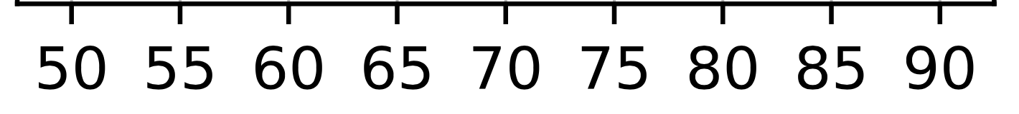
Attack Improvement 1: Making DRAM Cells More Vulnerable
An attacker can manipulate temperature to make the cells that store sensitive data more vulnerable
DRAM cells are vulnerable in a bounded temperature range
no bit flips
Vulnerable Temperature Range
no bit flips
Temperature
50°C
70°C
75°C
65°C
55°C
45°C
Heating up chip temperature
Cooling down chip temperature
Notes:
In the first example for an attack improvement, the attacker manipulates the DRAM module’s temperature to increase the RowHammer vulnerability of the cells that store sensitive data [CLICK]
We observe that DRAM cells are vulnerable to RowHammer in a bounded temperature range [CLICK]
that we call vulnerable temperature range [CLICK]
For example, let this range be from 50 to 70 degrees celsius for the victim cells
To attack the cells within their vulnerable temperature range, an attacker can [CLICK]
heat up the chip if its current temperature is below 50 [CLICK]
Or cool down the chip if its current temperature is above 70 degrees celsius [CLICK]

Slide 47
Attack Improvement 2: Temperature-Dependent Trigger
Identify abnormal increase in temperature to attack a data center during its peak hours
Precisely measure the temperature to trigger an attack exactly at the desired temperature
76.6%
of the cells*
1.
70 °C
Temperature
0.4%
of the cells*
2.
70 °C
Temperature
*Example fraction values from Mfr. C
Notes:
In the second attack example, the attacker uses RowHammer to understand the DRAM chip’s current temperature [CLICK]
As an example, more than 76% of the vulnerable cells experience bit flips above 70 degrees Celsius for Mfr C. Focusing on these cells, an attacker can identify abnormal operating conditions that might occur in a data center during its peak hours. This information can be used to trigger an attack when the data center is under pressure[CLICK]
If it is important to measure temperature precisely, the attacker can focus on a smaller set of vulnerable cells that experience bit flips only in a narrow temperature range. For example, 0.4% of vulnerable cells experience bit flips only at 70 degrees Celsius in Mfr C. Using these cells, the attacker can precisely detect the temperature and trigger an attack accordingly [CLICK]

Slide 48
Attack Improvement 3: Bypassing Defenses with Aggressor Row Active Time
Activating aggressor rows as frequently as possible:
Row A is active
Row B is active
Row A is active
Time
Keeping the aggressor rows active for a longer time:
Row A is active
Row B is active
36% reduction in HC_{first}
Time
Reduces the minimum activation count to induce a bit flip by 36%
Bypasses defenses that do not account for this reduction
Notes:
In the third example, an attacker can leverage the effect of aggressor row active time [CLICK]
In this scenario, instead of activating aggressor rows as frequently as possible, [CLICK]
the attacker can keep the aggressor rows active for longer time [CLICK]
Based on our analyses, HCfirst reduces by 36% on average with the proposed access pattern
With this reduction, an attacker can bypass RowHammer defenses that do not account for this reduction [CLICK]

Slide 49

Defense Improvements
Example 1: Leveraging the variation across DRAM rows
Example 2: Leveraging the variation with temperature
A DRAM cell experiences bit flips within a bounded temperature range
A row can be disabled within the row’s vulnerable temperature range
90%
HC_{first}
10%
Aggressiveness can be reduced:
33% area reduction for BlockHammer [Yağlıkçı+, HPCA'21]
$2×$HC_{first}
80% area reduction for Graphene [Park+, MICRO'20]
Breakdown of DRAM Rows
no bit flips
Vulnerable Temperature Range
no bit flips
Temperature
Disable RowA
Disable RowB
Temperature
Notes:
I will also explain two improvements for defense mechanisms in this slide, but you can find more in the paper [CLICK]
The first improvement leverages the variation across rows [CLICK]
We observe that 90% of the rows do not experience bit flips until the activation count reaches the double Hcfirst of the 10% of the rows.[CLICK]
Therefore, we can reduce the aggressiveness of defense mechanisms for 90% of the rows, which can reduce the area overheads of state-of-the-art defense mechanisms: [CLICK] BlockHammer and [CLICK] Graphene, by 33 and 80%, respectively [CLICK]
The second example leverages the variation in RowHammer vulnerability with temperature [CLICK]
We show that DRAM cells experience bit flips in bounded temperature ranges [CLICK]
To avoid bit flips, A DRAM row can be disabled when its cells are vulnerable to RowHammer at the current operating temperature [CLICK]

Slide 50
More Defense Implications in the Paper
Leveraging the similarity across subarrays in a DRAM module can reduce the module’s profiling time for RowHammer errors
Monitoring and limiting the aggressor row active time from the memory controller can reduce the RowHammer vulnerability and make defenses more efficient
ECC schemes can target the non-uniform bit error distribution caused by design-induced variation across DRAM columns
Cooling DRAM chips can reduce overall bit error rate
Notes:
We propose more defense improvements in the paper that I will briefly mention in this slide [CLICK]
First, Leveraging the similarity across subarrays in a DRAM module can reduce the module’s profiling time for RowHammer errors
Second, Monitoring and limiting the aggressor row active time from the memory controller can reduce the RowHammer vulnerability and make defenses more efficient
Third, ECC schemes can target the non-uniform bit error distribution caused by design-induced variation across DRAM columns
Fourth, Cooling DRAM chips can reduce overall bit error rate

Slide 51
Conclusion
Motivation:
Denser DRAM chips are more vulnerable to RowHammer
Understanding RowHammer enables designing effective and efficient solutions, but no rigorous study demonstrates how vulnerability varies under different conditions
Goal: Provide insights into three fundamental properties of RowHammer that can be leveraged to design more effective and efficient attacks and defenses
DRAM chip temperature
The time that an aggressor row stays active
Victim DRAM cell’s physical location
Experimental study: 272 DRAM chips from four major manufacturers
Key Results: We provide 6 takeaways from 16 novel observations
A RowHammer bit flip is more likely to occur
in a bounded range of temperature
if the aggressor row is active for longer time
in certain physical regions of the DRAM module under attack
Conclusion: Our novel observations can inspire and aid future work
Craft more effective attacks
Design more effective and efficient defenses
Notes:
Denser DRAM chips are more vulnerable to RowHammer [CLICK]
And Understanding RowHammer is critical to find effective and efficient solutions. However, no rigorous study demonstrates how this vulnerability varies under different conditions [CLICK]
In this work, our goal is to provide insights into three fundamental properties of RowHammer that can be leveraged to design more effective and efficient attacks and defenses These three properties are [CLICK]
DRAM chip temperature, [CLICK]
The time that an aggressor row stays active [CLICK]
and victim DRAM cell’s physical location [CLICK]
In this study, we test 272 real DRAM chips of DDR3 and DDR4 modules from four major manufacturers [CLICK]
Based on our analyses, we draw 6 key takeaway lessons from 16 novel observations. Among these, we highlight that [CLICK]
A RowHammer bit flip is more likely to occur [CLICK]
in a bounded range of temperature [CLICK]
if the aggressor row is active for longer time [CLICK]
And in certain physical regions of the DRAM module under attack [CLICK]
Based on our findings, we propose several improvements. We believe and hope that our novel observations will inspire and aid future work on crafting more effective attacks and designing more effective and efficient defense mechanisms [END]

Slide 52
If you have any questions feel free to ask :) Thank You!

